Slide 1
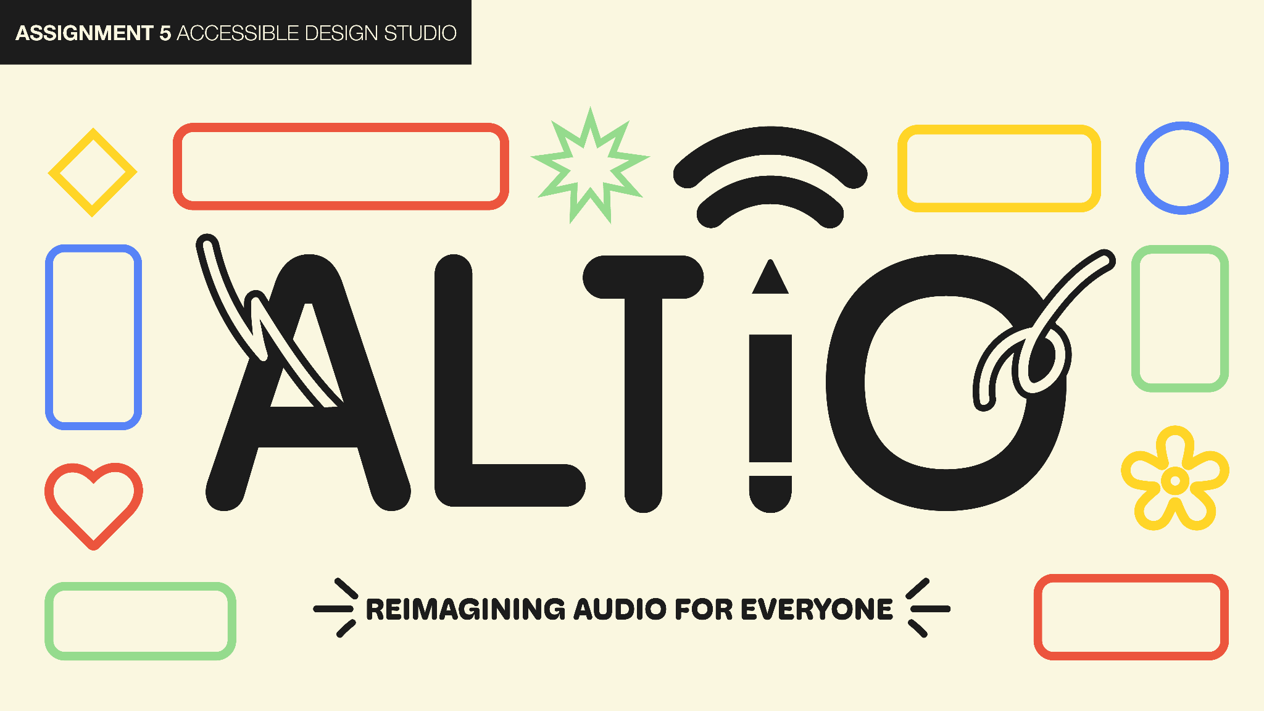

Slide 2
OVERVIEW
Our Mission
Interface Selection
Low-Fi Prototype
Experimental Methods
Key Results
Suggested UI Changes
Summary

Slide 3

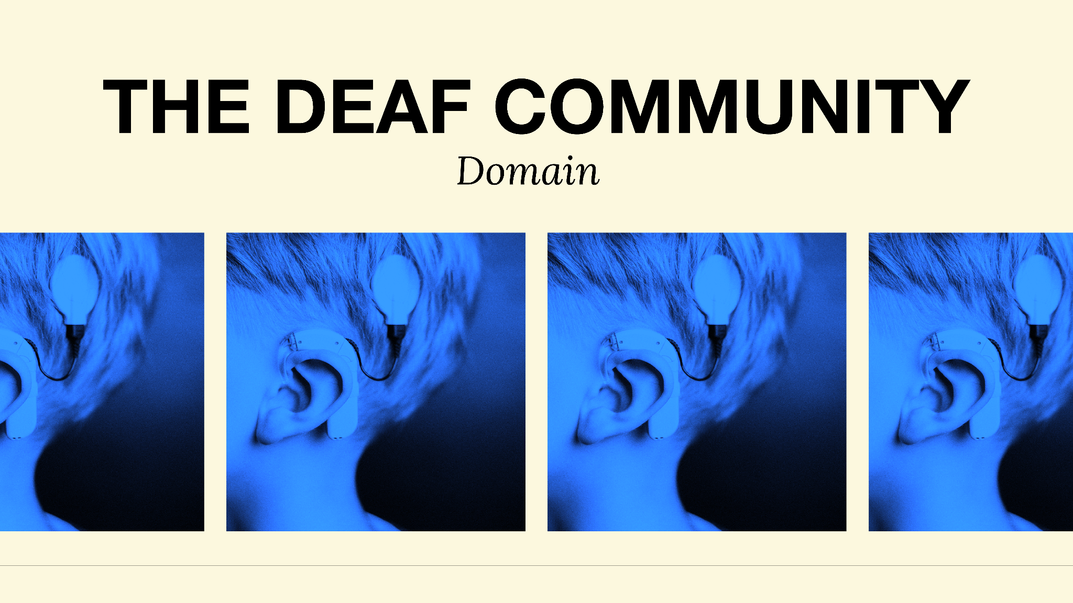

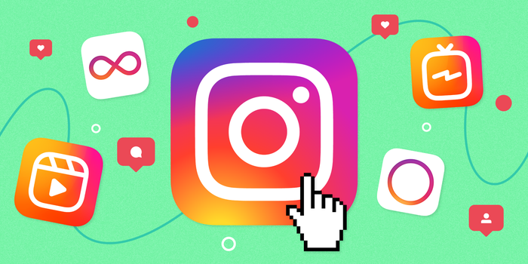
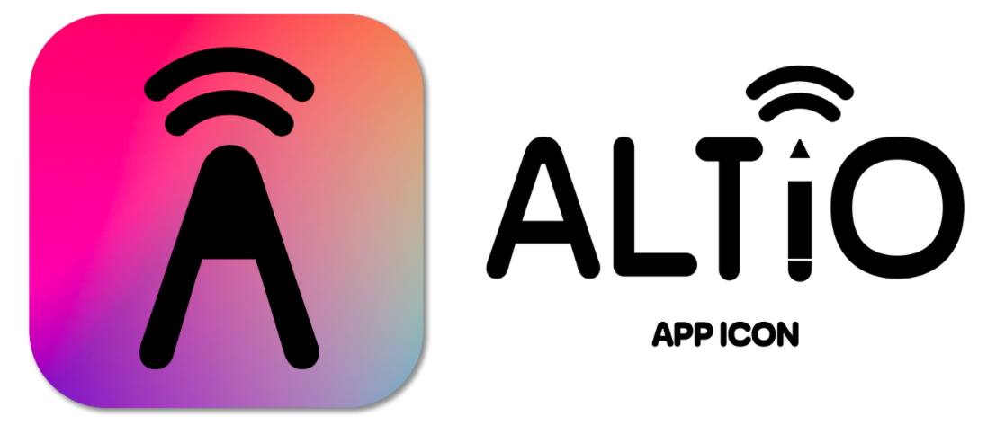
ABOUT ALTiO
Reimagining audio for everyone.
VALUE PROPOSITION:
Our goal is to make digital audio more accessible to the deaf and hard of hearing communities.

Slide 4
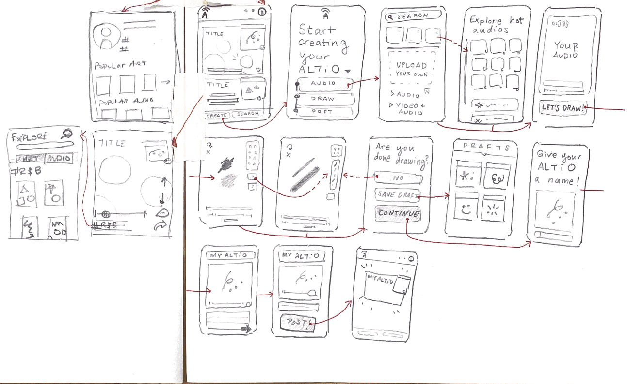
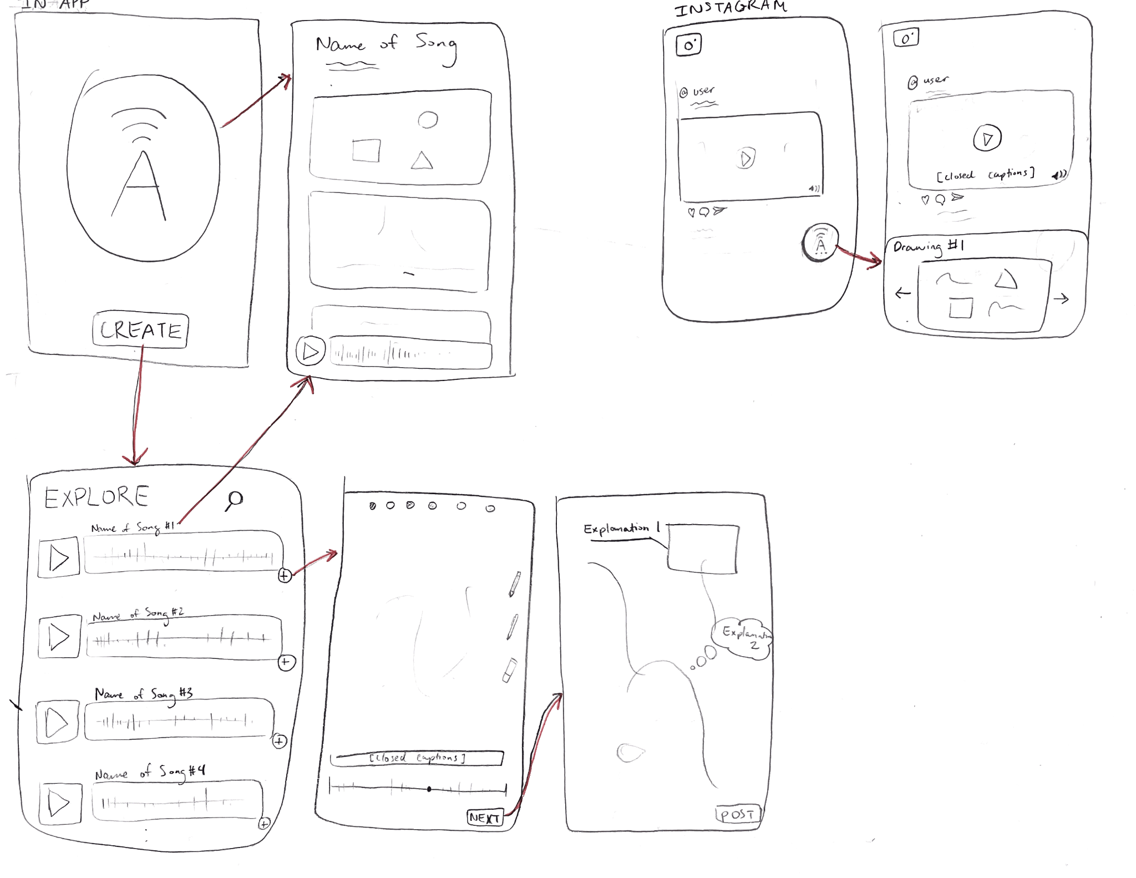
SELECTED INTERFACES
Interface A - Native Social Media App
Interface B - Audio Recognition / Plug-In
Social media platform with ALTiO
Requires ALTiO interpretations be posted as a supplement to all content with audio
Audio recognition
Visual interpretations for recognized audio
Volunteers interpret songs

Slide 5
SELECTION RATIONALE
 | Interface A - Native Social Media App | Interface B - Audio Recognition / Plug-In
Pros | Easy to customize drawing to video's audio Full control of content types Every video will have a drawing | Versatile for all apps Listen to music in your place Drawing interpretations is buy in activity (only on what you want) Focus on the music (audio) itself
Cons | Only for users on the app Takes long to post content (interpret on top of post) - may discourage people from posting | Maybe less People will draw May be difficult to implement Artists pick which audio to interpret for - not all content will have interpretations
Reasoning for selection:
Since the mission of ALTiO is to make digital audio more accessible to the deaf and hard of hearing community, we want to make sure that all content on this platform is deaf/hard of hearing-friendly.

Slide 6
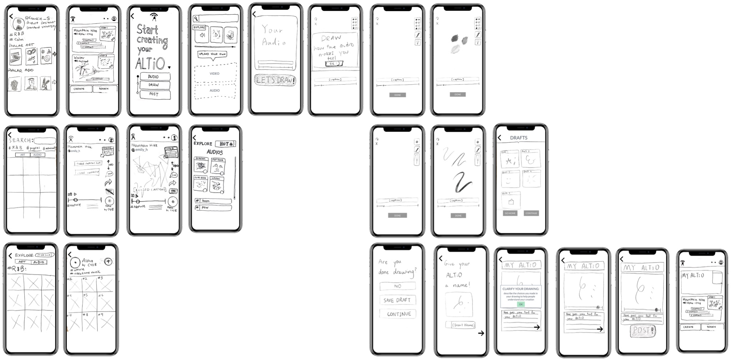
LOW-FI PROTOTYPE STRUCTURE
Built with sketches and Marvel App

Slide 7
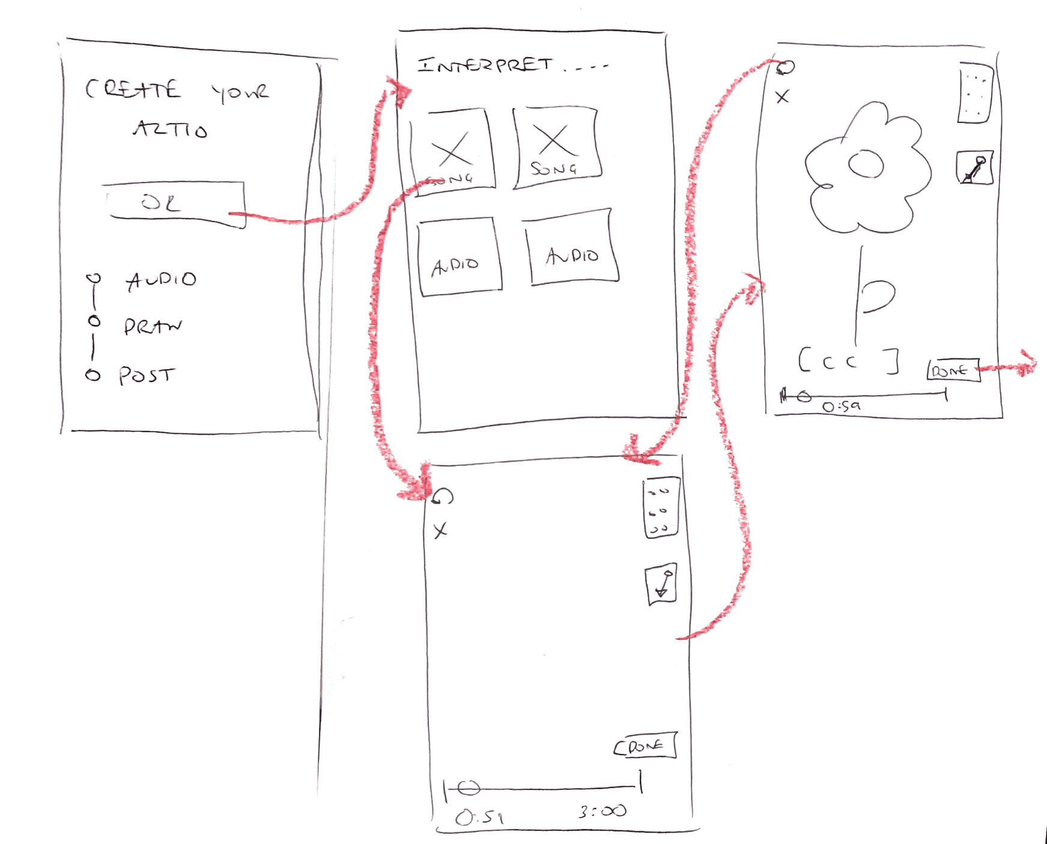
SIMPLE TASK:
Interpret audio
Explanation:
The user follows the prompts to create a post and add a drawing.

Slide 8
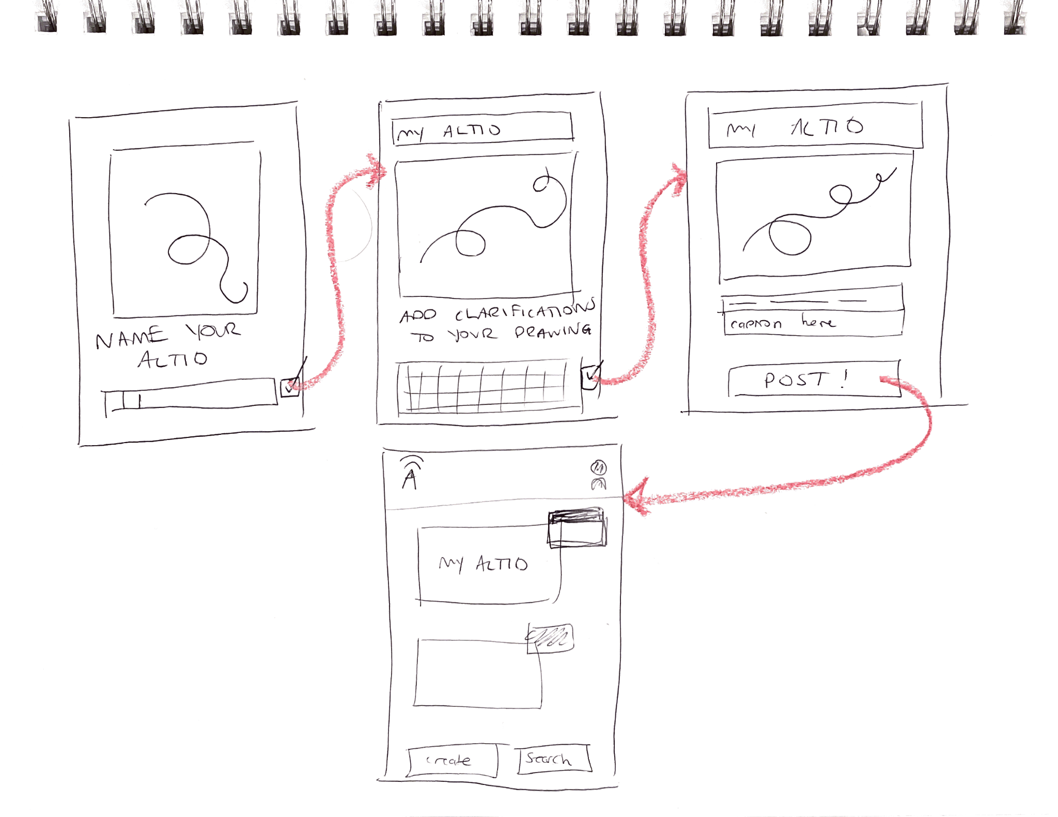
MODERATE TASK:
Explain and clarify interpretation
Explanation:
The user follows the prompts to name their ALTiO and add captions/explanation.

Slide 9
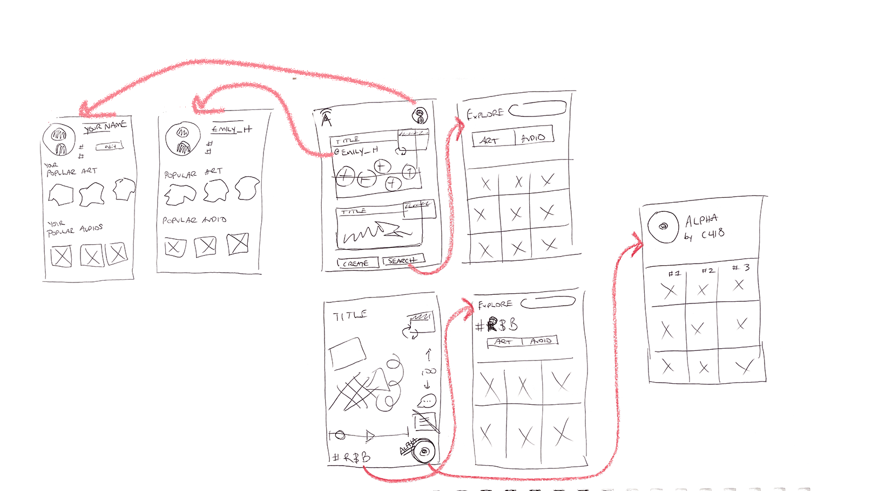
COMPLEX TASK:
Interact with various interpretations and artists on the platform
Explanation:
The user explores different contents in the app. Playing around with the profile page, hashtags, and posts in the feed.

Slide 10
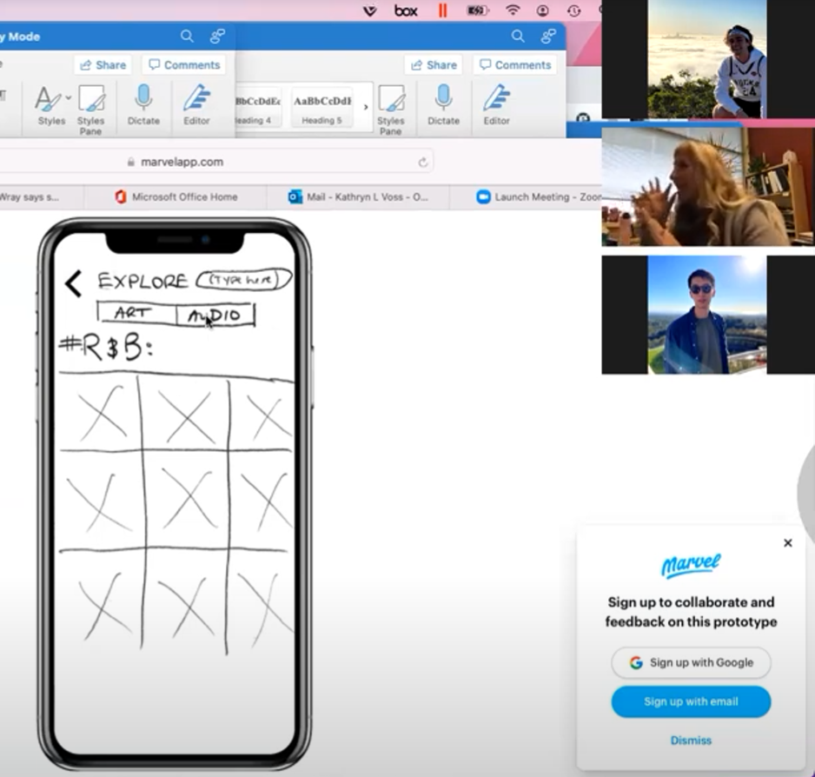
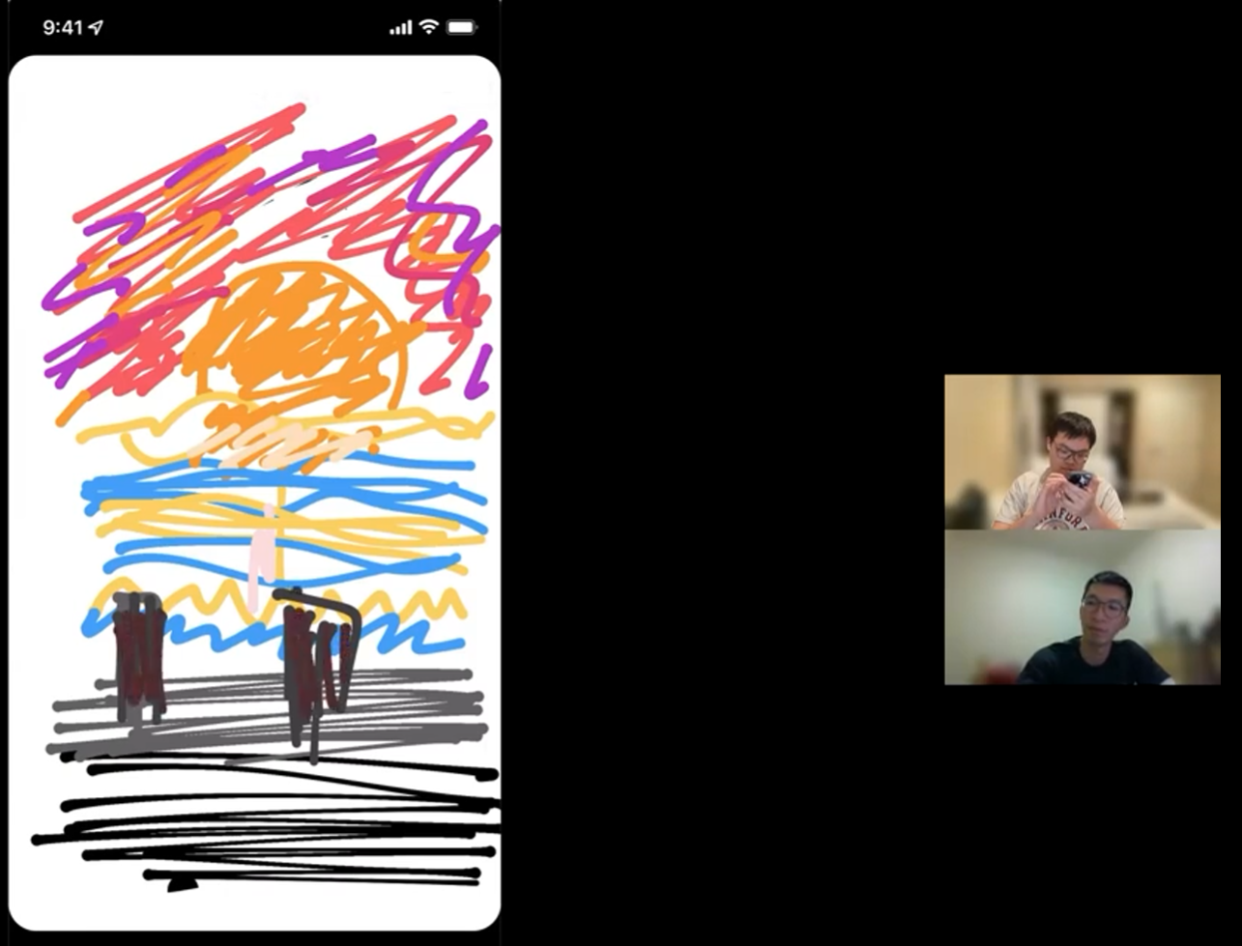
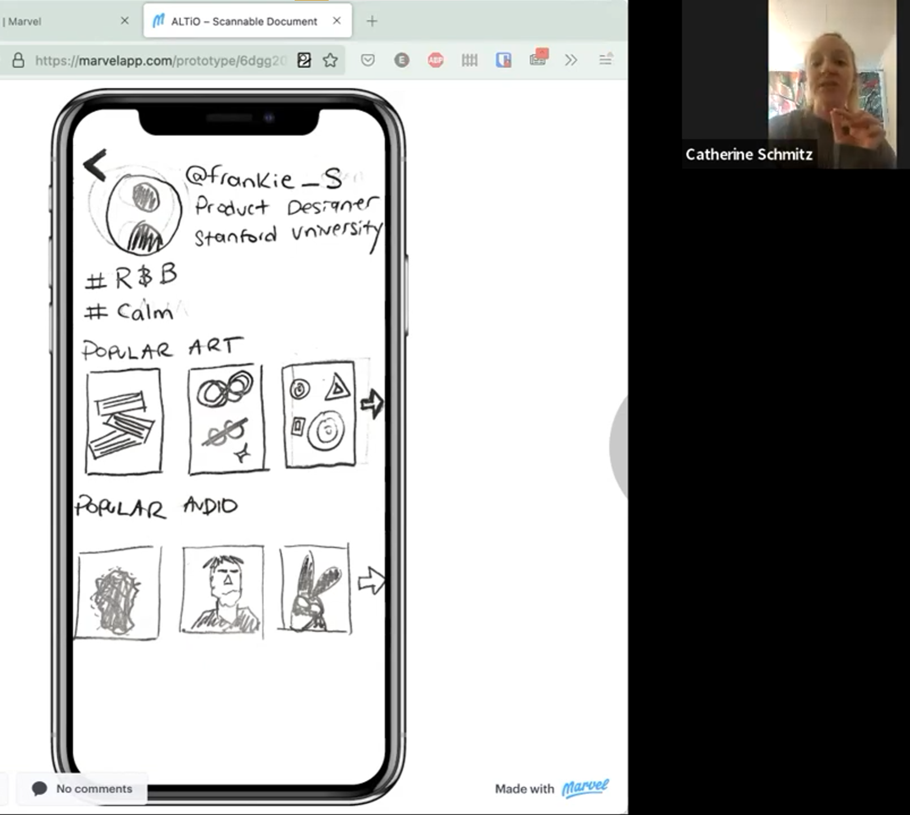
Experimental Methods
Participants | Katie, Matthew, Catherine
Environment | Zoom calls & screen sharing (web apps and mobile apps)
Usability Goals | Discoverable, Fun
Procedure | Introduction to the app ⇒ navigate & explore on Marvel app ⇒ (draw to music) ⇒ feedback
Team Member Roles | Greeter/Facilitator: Emily/Po-Ting/Frankie; Notetaker: Po-Ting/Emily/Jared

Slide 11
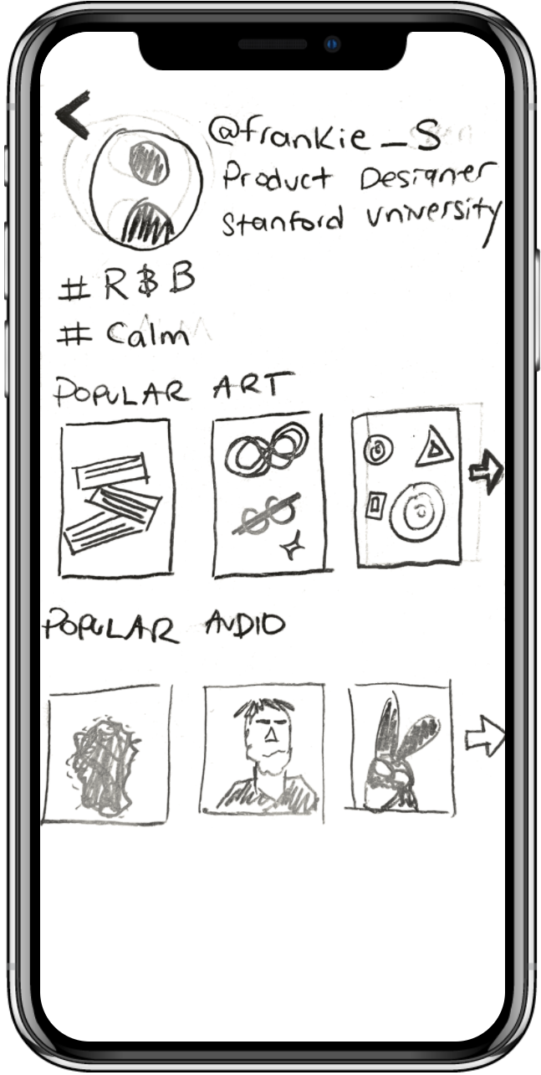
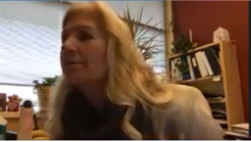
Result 1
The idea of ALTiO needs clearer explanation.
The deaf user did not understand what the app is doing at first.
It took ~15 minutes for the deaf user to understand the app.
The word “audio” can make deaf people feel worried or nervous.
Consider adding guidance explaining the app and each function.

Slide 12
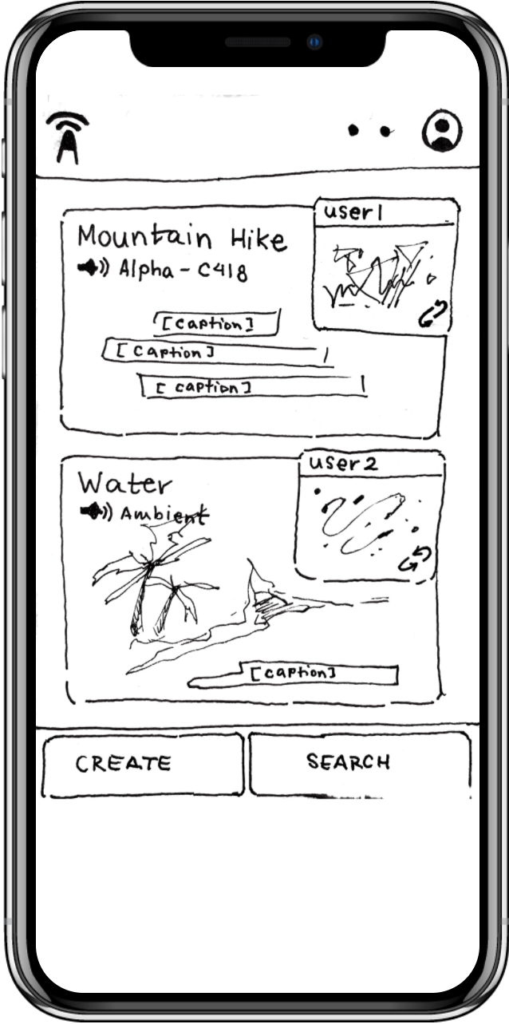
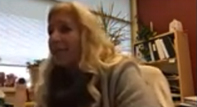
Result 2
Deaf user was excited about the visual emphasis present in the app.
Our target audience relies heavily on visual elements.
Consider attractive and inclusive visual designs.

Slide 13
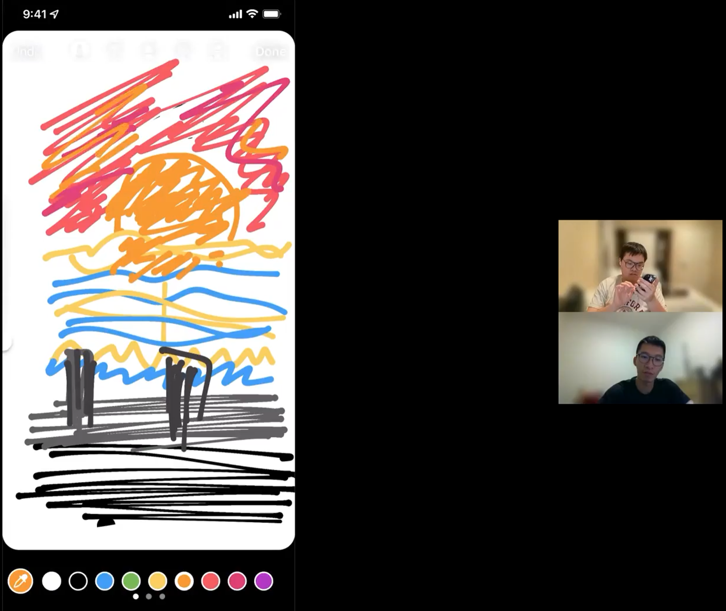
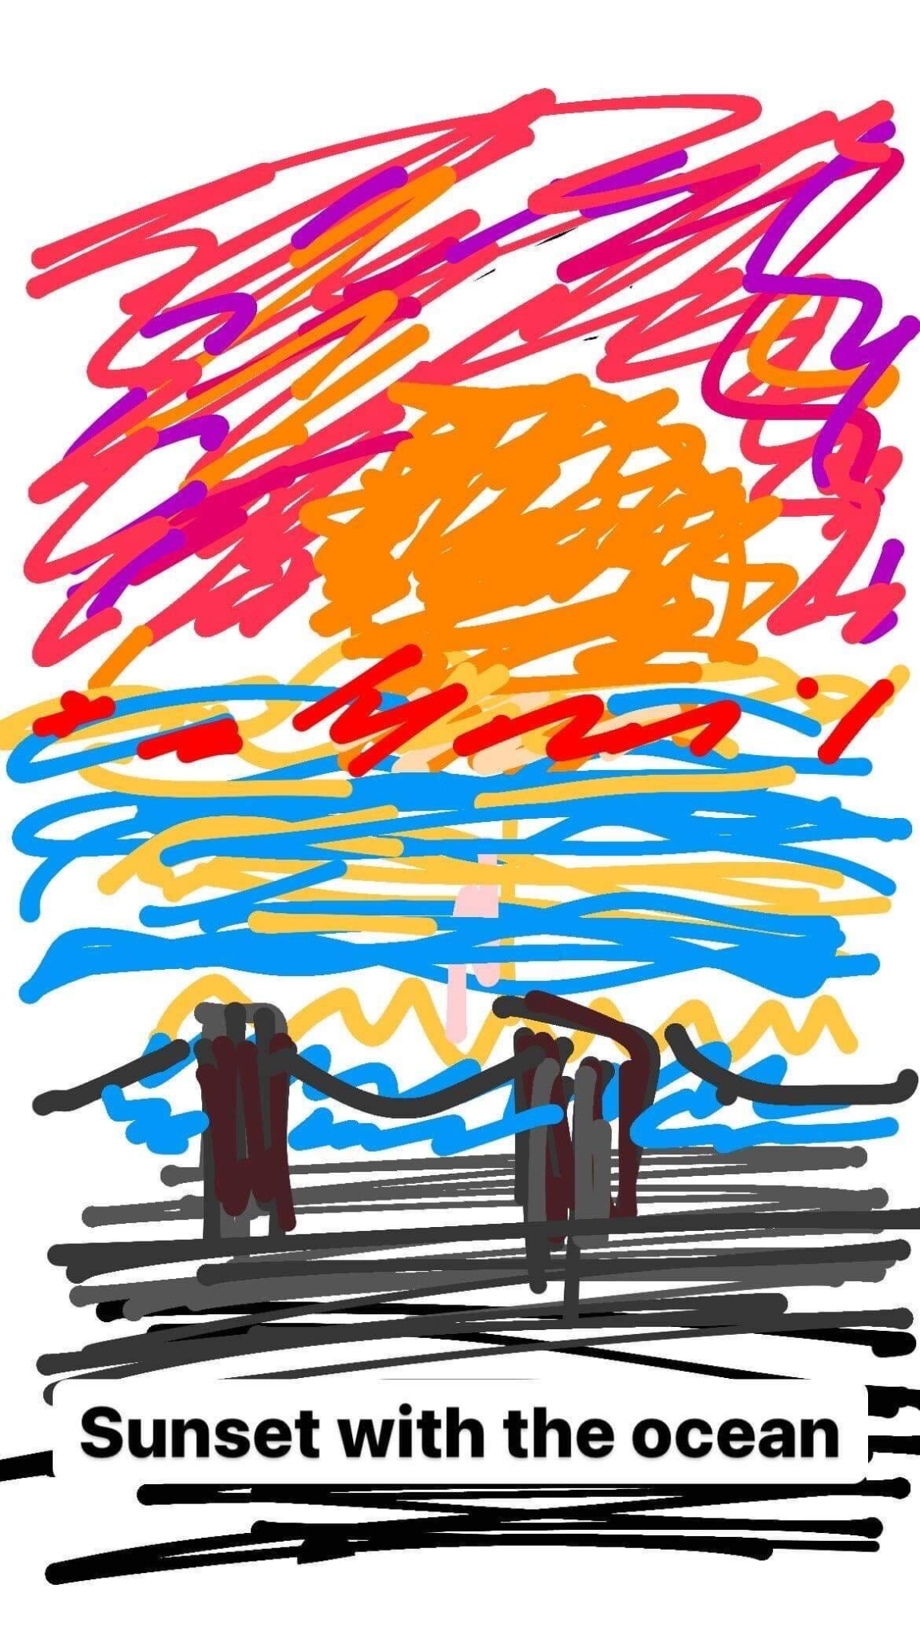
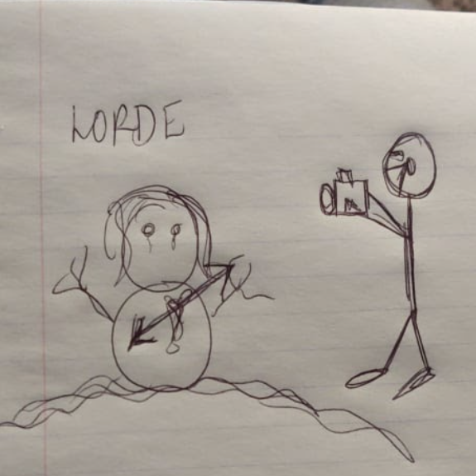
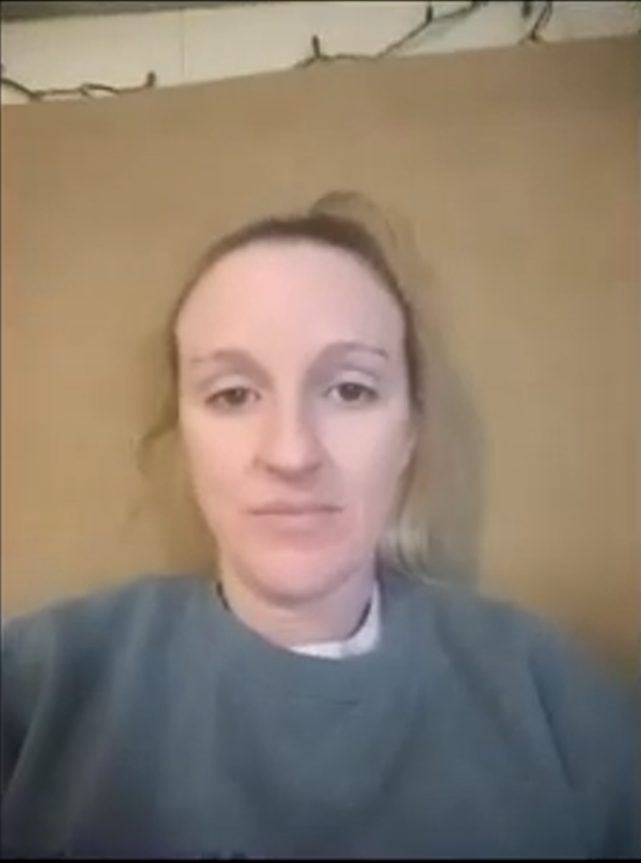
Result 3
The user was very focused when drawing. The user did not request to pause, rewind, or replay the song throughout the drawing process.
Consider design the UI of the interpretation section to be drawing-focused.
Perhaps make the interaction with the audio as simple as possible when the user is drawing.
Consider making the drawing more fun with more functionalities.

Slide 14
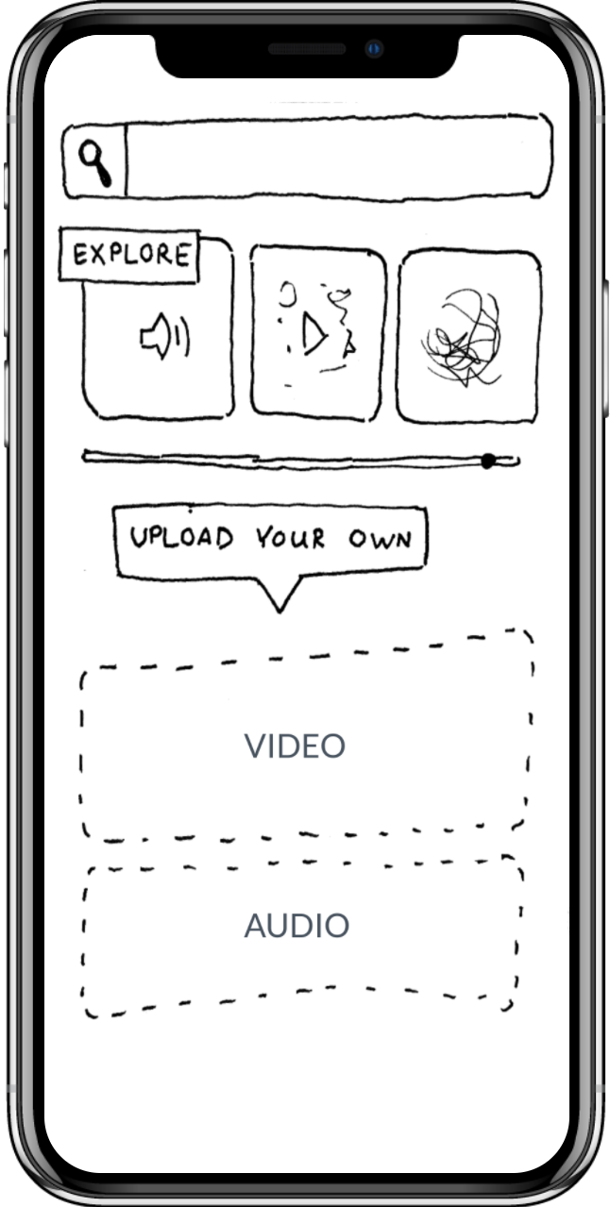
Suggested UI Change 1
Add an option for videos to be posted without audio and instead solely with their drawing supplement.
Provide more options, such as drawing only or photos with drawing.
Include deaf/hard of hearing people to create contents.
SIMPLY DRAW

Slide 15
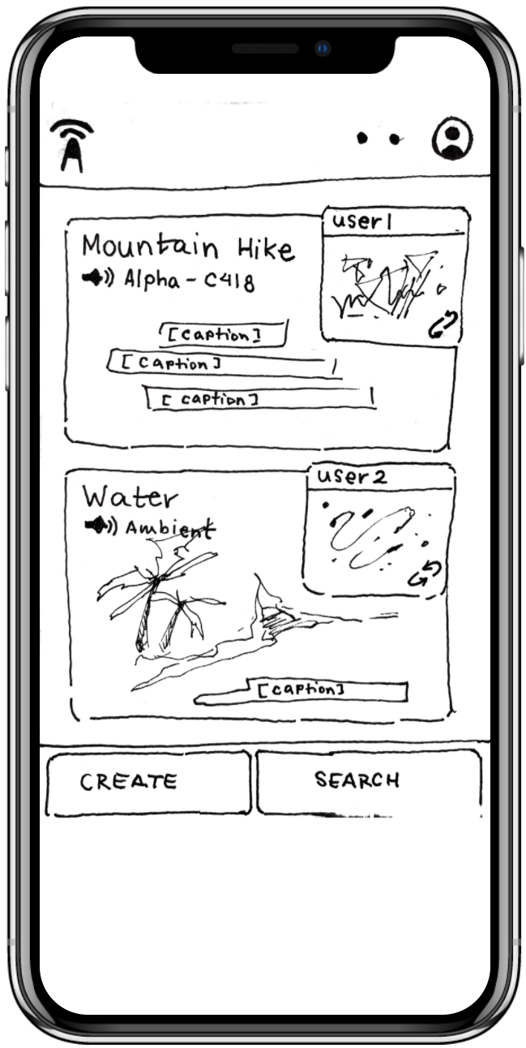

Suggested UI Change 2
An introduction or explanation as to what the ALTiOs are doing for new users.
Check out your profile page here.
This is your profile page.
Captions are shown, it can be turned on/off here
This is your feed, where you can browse others’ content.
Search content here!
Your posts go here.
Create a content here!

Slide 16
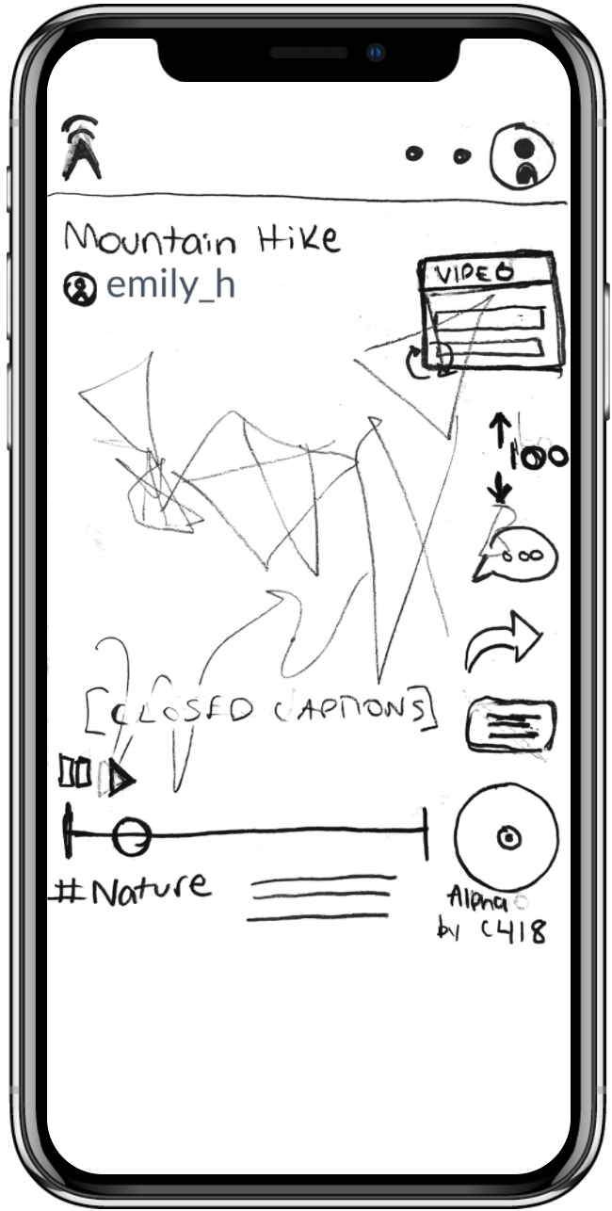
Suggested UI Change 3
Captions design: to not obstruct the actual content of the video, but also provide sufficient captioning.
Captions are extremely important for deaf and hard of hearing people when interacting with videos.
Need good captions design
Allow custom captions styles?

Slide 17
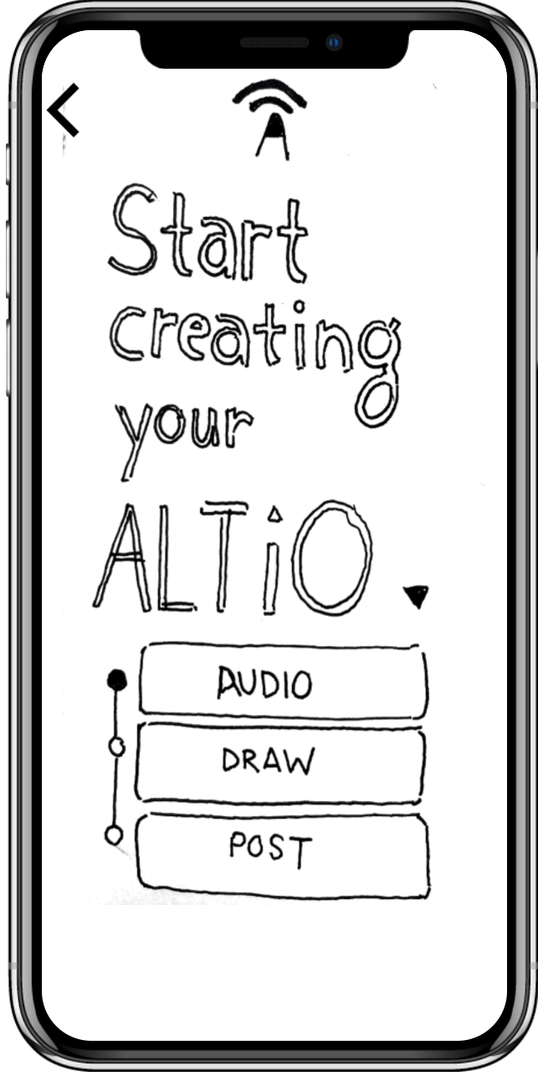
Suggested UI Change 4
The user wanted to incorrectly click “draw” on the page to begin creating the interpretation.
Consider redesigning the UI.
Incorporate more options for creating content.

Slide 18
SUMMARY
The current interface is similar to other social media. We should consider adding more unique features centering the ALTiO for deaf and hard of hearing community.
Drawing your feeling about music is a cool idea. Keep in mind to include deaf people in our future design.
The UI in our low-fi prototype should be changed to provide more clarity on how ALTiO works and on how to create a content with ALTiO.

